Slide 1

Amazon Web Services
Jeff Barr
jbarr@amazon.com
Senior Web Services Evangelist
Amazon Web Services
Notes:
1
Mention partners who contributed to this version of the Business Objects Crystal Reports appliance:
rPath
Citrix
Amazon Web Services
RightScale

Slide 2
Who am I?
Software Development Background
Programmable Applications and Sites
Microsoft Visual Basic and .Net Teams
Startup / Venture Consultant
6 Years with Amazon
  Developer
  Evangelist
  Blogger

Slide 3
Things to Remember
AWS Site: aws.amazon.com
AWS Blog: aws.typepad.com
My Email: jbarr@amazon.com

Slide 4
What is Cloud Computing?
Emerging Trend
Large-Scale Shared Resources
Capacity on Demand
Pay as You Go

Slide 5
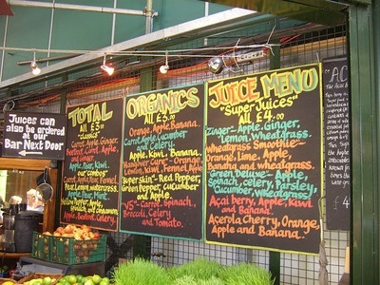
Cloud Computing Attributes
Abstracted Resources
Cost-Effective
Scale Up & Scale Down
Fault Tolerant

Slide 6
The Economics
No Up-Front Capital Investment
Start Small & Pay as You Grow
Use What You Need
Reduced Development Time
Simplified Architecture

Slide 7
Cloud Computing Components

Slide 8

amazonaws.com

Slide 9
amazonaws.com
Free developer account
REST and SOAP Cloud APIs
WSDL files
Voluminous documentation
Sample code
Usage-based billing
$0.10 - $0.17 / GB bandwidth

Slide 10
amazonaws.com
Message Queue
Message Queue
Message Queue

Slide 11
amazonaws.com
Message Queue
Message Queue
Message Queue
SQS
Amazon Simple Queue Service
Scalable message queue
Elastic capacity
$.01 for 10,000 messages

Slide 12
amazonaws.com
Message Queue
Message Queue
Message Queue
Object Storage
Object Storage
Object Storage

Slide 13
amazonaws.com
S3
Amazon Simple Storage Service
Scalable object storage
Distributed, redundant
1B – 5 GB / object
Public or private
URL-addressable
$.15 / GB / month
Message Queue
Message Queue
Message Queue
Object Storage
Object Storage
Object Storage

Slide 14
amazonaws.com
Message Queue
Message Queue
Message Queue
Object Storage
Indexed
Storage
Object Storage
Object Storage

Slide 15
amazonaws.com
SDB
Amazon SimpleDB
Indexed data storage
Distributed, redundant
Schemaless
Elastic capacity
Query language
$1.50 / GB / month
Message Queue
Message Queue
Message Queue
Object Storage
Indexed
Storage
Object Storage
Object Storage

Slide 16
amazonaws.com
Message Queue
Message Queue
Message Queue
Elastic
Computing
Object Storage
Indexed
Storage
Object Storage
Object Storage

Slide 17
EC2
Amazon Elastic Compute Cloud
Scalable processing power
Small, medium, or large
Linux or OpenSolaris
Root-level access
Management API
$0.10 - $0.80 / instance / hour
amazonaws.com
Message Queue
Message Queue
Message Queue
Elastic
Computing
Object Storage
Indexed
Storage
Object Storage
Object Storage

Slide 18
amazonaws.com
Message Queue
Block
Storage
Message Queue
Message Queue
Elastic
Computing
Object Storage
Indexed
Storage
Object Storage
Object Storage

Slide 19
amazonaws.com
Message Queue
Block
Storage
Message Queue
Message Queue
Persistent Block Storage
1 GB – 1 TB allocation
High-performance
Mount on EC2 instance
Format as filesystem
Snapshot backup to S3
Elastic
Computing
Object Storage
Indexed
Storage
Object Storage
Object Storage

Slide 20
amazonaws.com
Message Queue
Block
Storage
Message Queue
Message Queue
Elastic
Computing
Object Storage
Indexed
Storage
Object Storage
Object Storage
IP Addresses

Slide 21
amazonaws.com
Message Queue
Block
Storage
Message Queue
Elastic IP Addresses
Allocate as needed
Attach to EC2 instance
Remap as needed
Message Queue
Elastic
Computing
Object Storage
Indexed
Storage
Object Storage
Object Storage
IP Addresses

Slide 22
amazonaws.com
Message Queue
Block
Storage
Message Queue
Message Queue
Elastic
Computing
Object Storage
Indexed
Storage
Object Storage
Object Storage
Metering
Billing
IP Addresses

Slide 23
amazonaws.com
Message Queue
Block
Storage
Message Queue
Metering & Billing
Dynamic usage tracking
Monthly credit card billing
Usage reports
Portal
Message Queue
Elastic
Computing
Object Storage
Indexed
Storage
Object Storage
Object Storage
Metering
Billing
IP Addresses

Slide 24
Amazon EC2
in Depth

Slide 25
EC2 Instance Types
XL
L
S
1.7 GB RAM,
1 EC2 Compute Unit
160 GB
32-bit platform
7.5 GB RAM
4 EC2 Compute Units
850 GB
64-bit platform
15 GB RAM,
8 EC2 Compute Units
1690 GB storage,
64-bit platform
$0.10/Hr
$0.40/Hr
$0.80/Hr

Slide 26
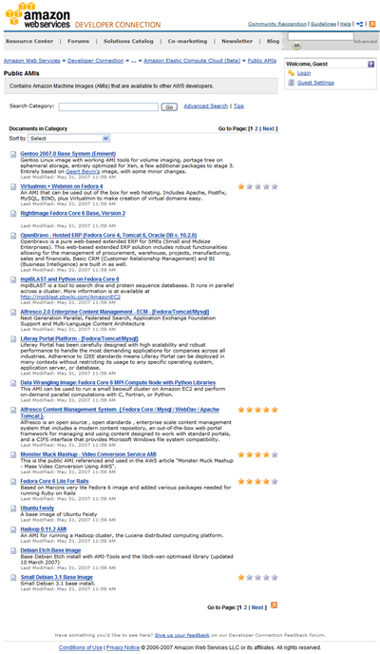
Amazon EC2 Concepts
Amazon Machine Image (AMI):
  Bootable root disk stored in S3
  Pre-defined or user-built
  Catalog of user-built AMIs
  OS: Fedora, Centos, Gentoo, Debian,
  Ubuntu, RHEL, Windows Server
  New: OpenSolaris
  App Stack: LAMP, mpiBLAST, Hadoop
Instance:
  Running copy of an AMI
  Launch in less than 2 minutes
  Start/stop programmatically
Network Security Model:
  Explicit access control
  Security groups
Inter-service bandwidth is free
26
26

Slide 27
EC2 API
Images:
  RegisterImage
  DescribeImages
  DeregisterImage
Instances:
  RunInstances
  DescribeInstances
  TerminateInstances
  GetConsoleOutput
  RebootInstances
Keypairs:
  CreateKeyPair
  DescribeKeyPairs
  DeleteKeyPair
Image Attributes:
  ModifyImageAttribute
  DescribeImageAttribute
  ResetImageAttribute
Security Groups:
  CreateSecurityGroup
  DescribeSecurityGroups
  DeleteSecurityGroup
  AuthorizeSecurityGroupIngress
  RevokeSecurityGroupIngress

Slide 28
EC2 Availability Zones
Fault isolation
Run instances in specified zones
Low latency zone-to-zone access
Geographic Region
us-east-1a
us-east-1b
us-east-1c

Slide 29
EC2 Persistent Storage
C:\> ec2-create-volume -s 549755813888
VOLUME vol-4695702f 549755813888 creating 2008-04-13T22:17:35+0000
C:\> ec2-create-volume -s 549755813888
VOLUME vol-59957030 549755813888 creating;2008-04-13T22:17:49+0000
C:\> ec2-describe-volumes
VOLUME vol-4695702f 549755813888 available 2008-04-13T22:17:35+0000
VOLUME vol-59957030 549755813888 available 2008-04-13T22:17:49+0000
c:\> ec2-attach-volume vol-4695702f -i i-6b3bfd02 -d /dev/sdb
ATTACHMENT vol-4695702f i-6b3bfd02 /dev/sdb attaching 2008-04-13T22:36:32+0000
C:\> ec2-attach-volume vol-59957030 -i i-6b3bfd02 -d /dev/sdc
ATTACHMENT vol-59957030 i-6b3bfd02 /dev/sdc attaching 2008-04-13T22:36:55+0000
# mkfs -t ext3 /dev/sdb
# mkfs -t ext3 /dev/sdc
# mkdir /space1 /space2
# mount /dev/sdb /space1
# mount /dev/sdc /space2

Slide 30
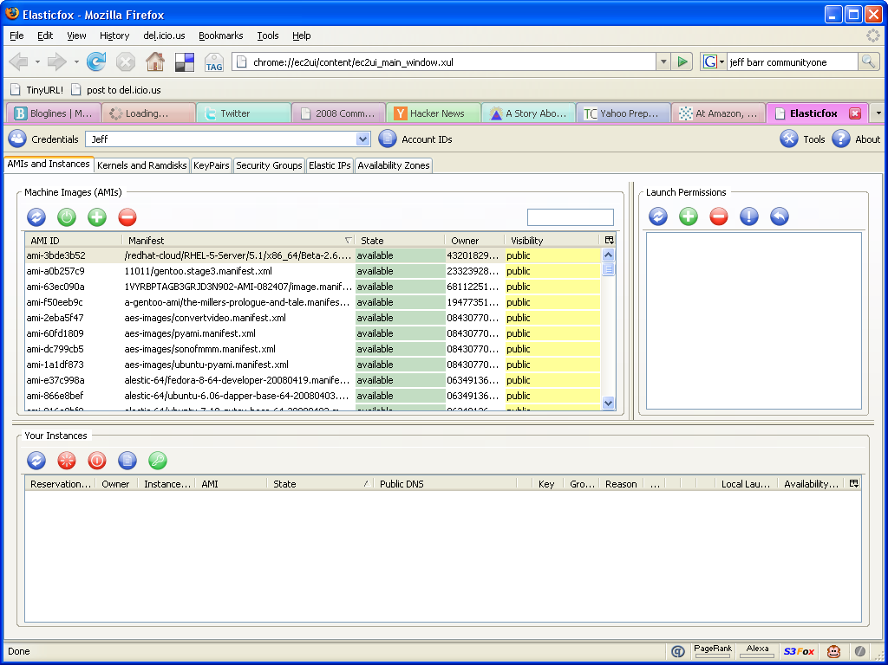

Slide 31
AWS
By The Numbers

Slide 32
Bandwidth Consumed by
Amazon Web Services
Bandwidth Consumed by
Amazon’s Global Websites
2001
2002
2003
2004
2005
2006
2007
2008
Notes:
You all know about Amazon. You may not be aware of the early success we’re seeing with our AWS business.

Slide 33


Amazon S3 Objects
18,000,000,000
10,000,000,000
5,000,000,000
800,000,000
July
2006
April
2007
October
2007
March
2008

Slide 34
Registered AWS Developers
160,000
Q1 2006
240,000
Q1 2007
370,000
Q1 2008

Slide 35
AWS
in Action

Slide 36
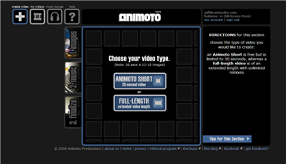
Scaling Challenge: Animoto
Dynamic Music Video Generator
Upload images
Upload music
Generate music video
Facebook Application

Slide 37

Everyone Showed Up

Slide 38
Scaling in Action
Viral Growth mid-April:
  Monday: 25K Users
  Tuesday: 50K Users
  Wednesday: 100K Users
  Thursday: 250K Users
EC2 + S3 + RightScale

Slide 39
Animoto’s EC2 Instances

Slide 40
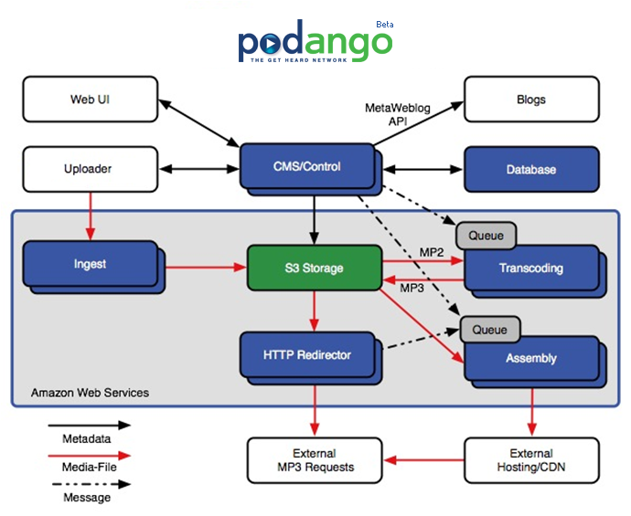
SQS At Work

Slide 41
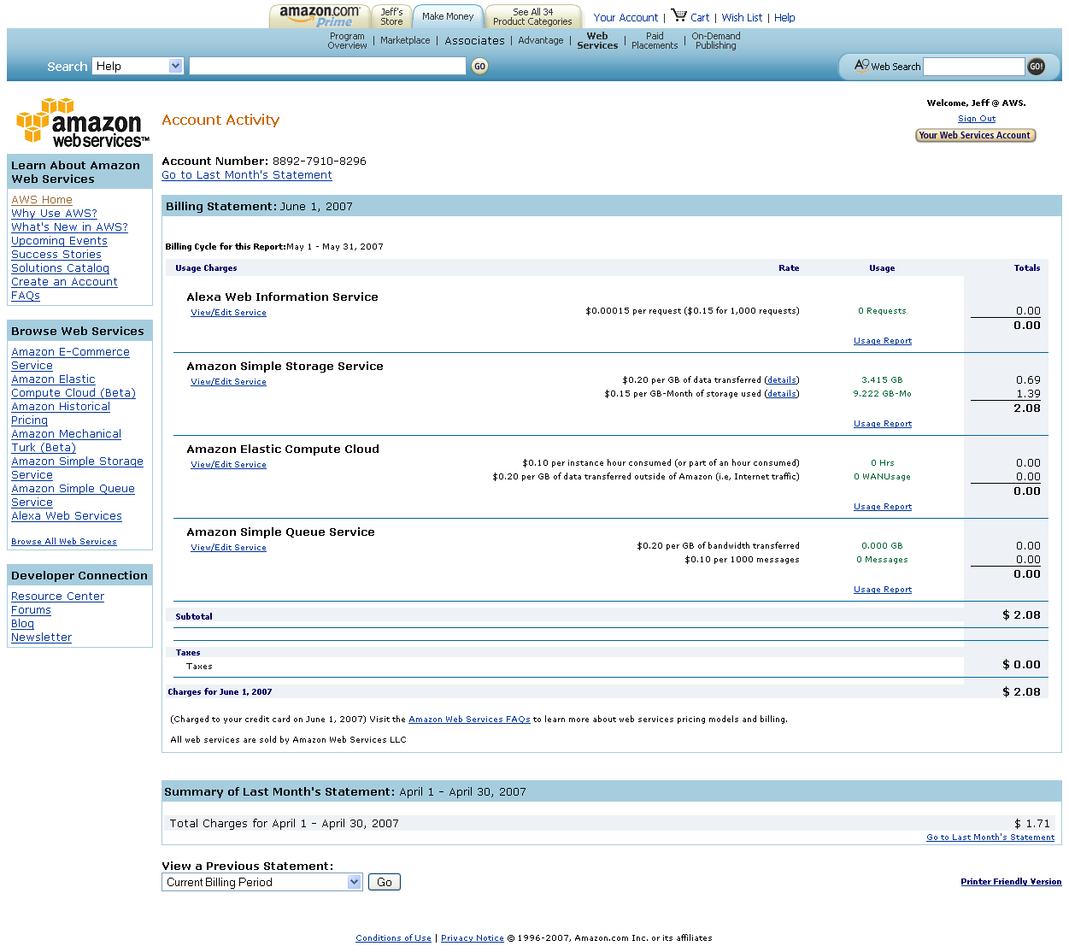

Web Services Billing

Slide 42
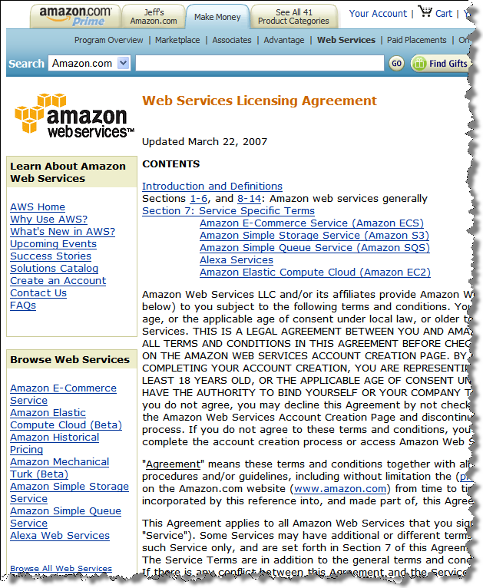
The Commercial Side
Standard licensing terms
Commercially usable
Monthly credit card billing
Self-serve model:
  Sign up as developer
  Choose services
  Agree to service licenses
  Enter payment info
  Start coding

Slide 43
Q&A

Slide 44
Things to Remember
AWS Site: aws.amazon.com
AWS Blog: aws.typepad.com
My Email: jbarr@amazon.com

Slide 45
Thank You!

